Slide 1
Accurate Reconstruction of All-Atom Protein Representations From Side-Chain-Based Low-Resolution Models
Michael Feig, Piotr Rotkiewicz, Andrzej Kolinski, Jeffrey Skolnick, and Charles L. Brooks III,
PROTEINS: Structure, Function, and Genetics 41:86–97 (2000)
Presenter : Hsiao-Yen Chang
Date : September 5, 2007

Slide 2
Abstract
A procedure for the reconstruction of all-atom protein
structures from side-chain center-based low-resolution
models is introduced and applied to a set of test proteins
with high-resolution X-ray structures. The accuracy of the
rebuilt all-atom models is measured by root mean square
deviations to the corresponding X-ray structures and
percentages of correct x1 and x2 side-chain dihedrals. The
benefit of including C_{α} positions in the low-resolution
model is examined, and the effect of lattice-based models
on the reconstruction accuracy is discussed.

Slide 3
Low-Resolution Models
The low-resolution protein model used in this article is based on the SICHO model by Kolinski and Skolnick [26].
  It consists of a chain of virtual particles located at the (geometric) side-chain center of each amino acid residue.
  The side-chain centers are calculated by averaging the positions of all heavy side-chain atoms including the C_{α} atom.
  An extended model, called SICHO/C_{α}, that contains the C_{α} positions and the side-chain centers.

Slide 4
Low-Resolution Models (cont.)
Kolinski and Skolnick use a projection of the SICHO model onto a cubic lattice grid with a mesh size of 1.45 Å.
we also apply the reconstruction procedure to models where the side-chain centers, and C_{α} coordinates in the extended model, are projected onto cubic grids with mesh sizes from 0.2 to 2.0 Å.

Slide 5
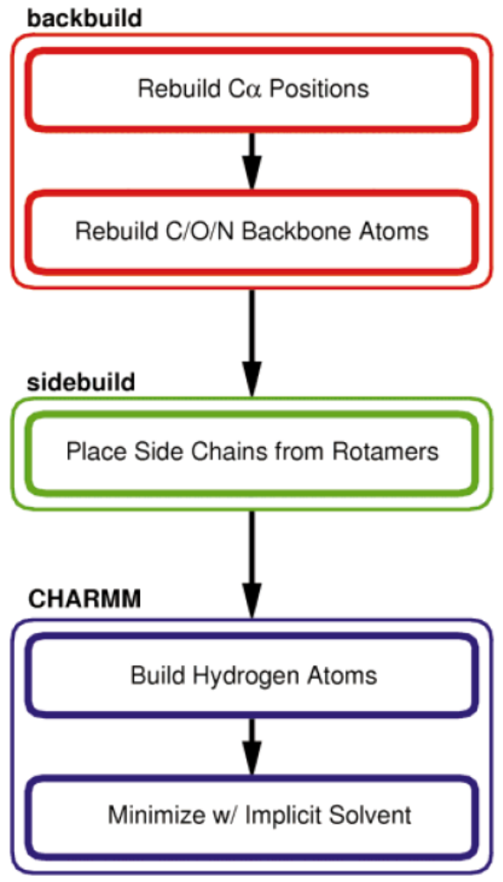
Reconstruction Procedure

Slide 6
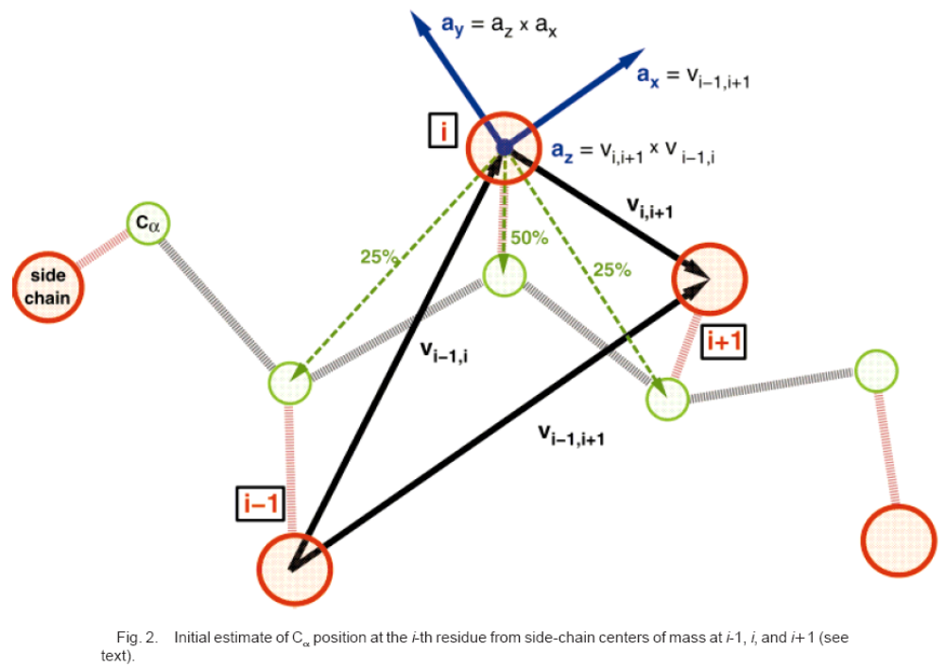
Backbone Reconstruction
Average relative Cα positions were obtained by analyzing ～200,000 residues in 824 chains of selected non-homologous, high-resolution PDB structures.

Slide 7
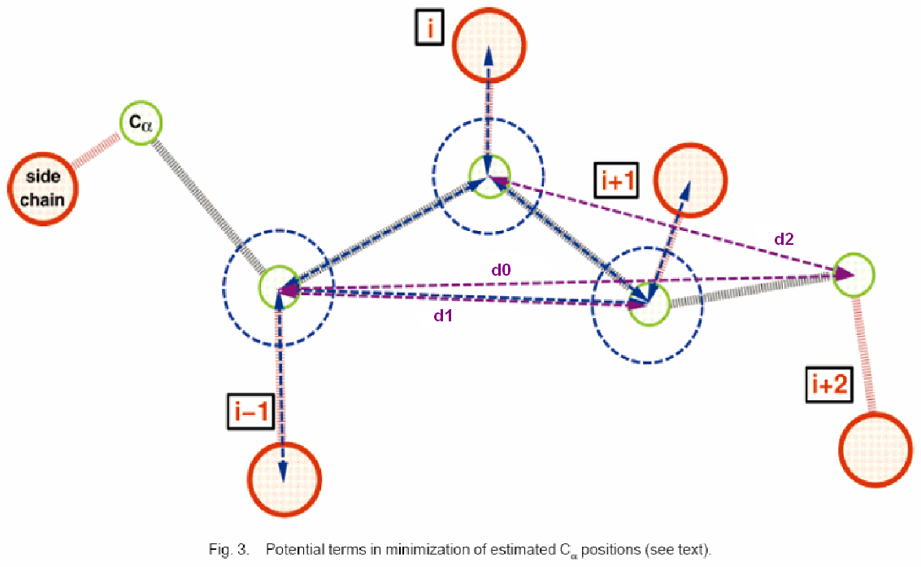
Backbone Reconstruction (cont.)

Slide 8
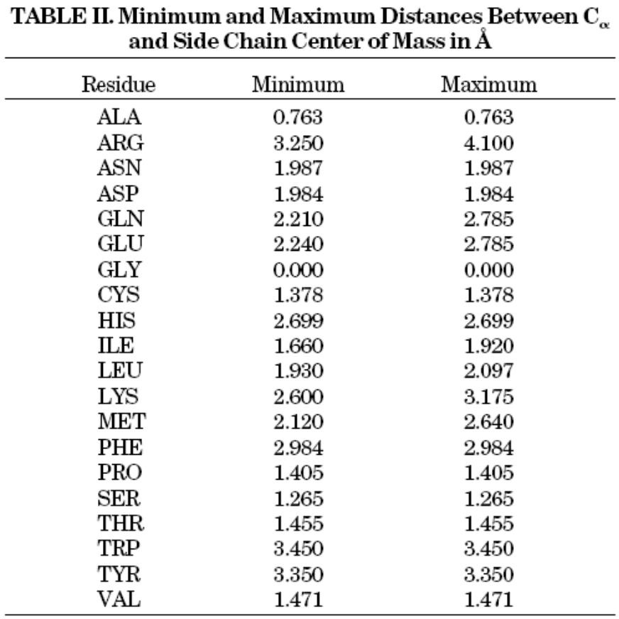
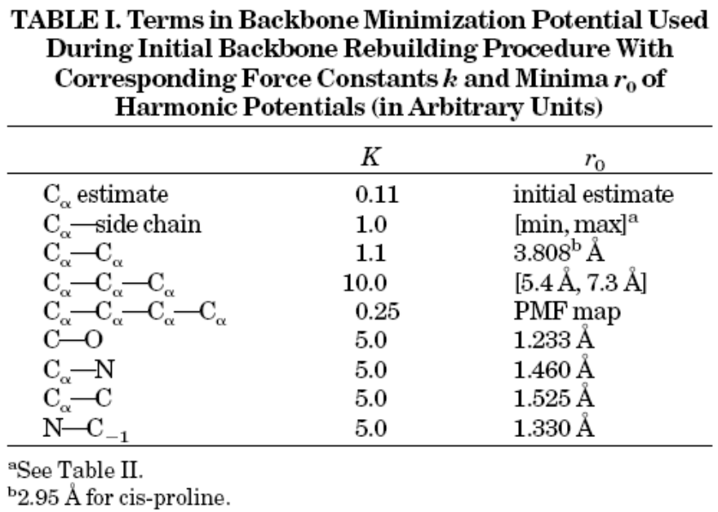
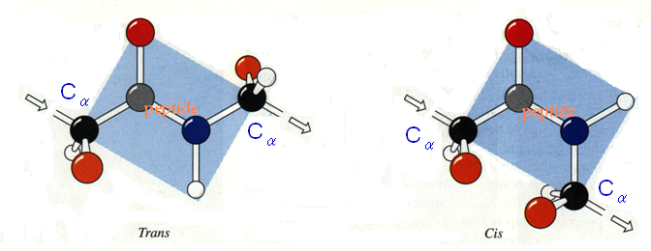
Backbone Reconstruction (cont.)

Slide 9
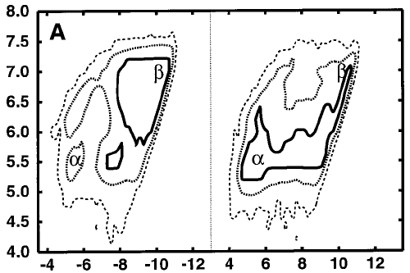
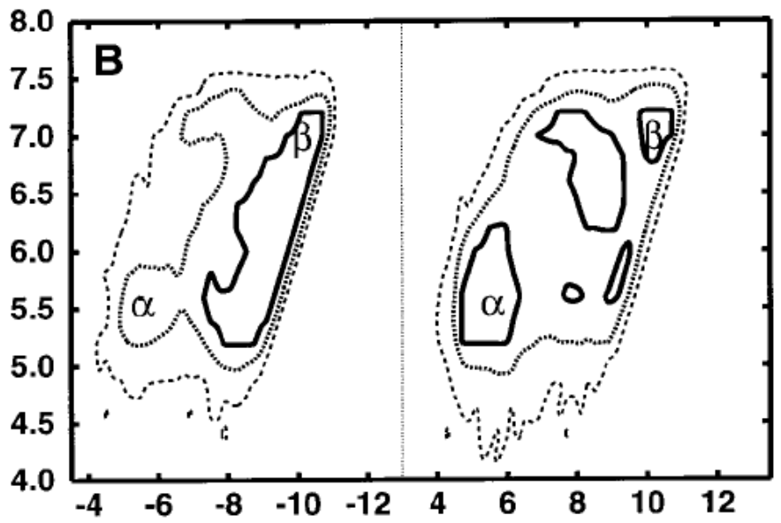
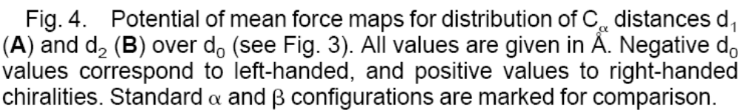
Backbone Reconstruction (cont.)

Slide 10
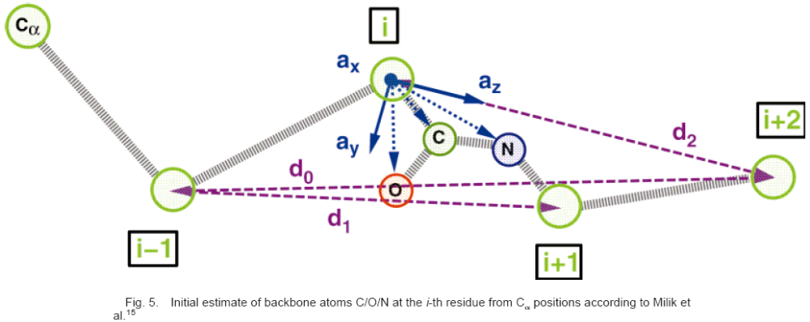
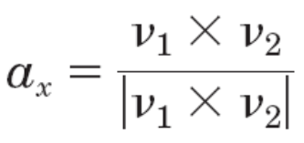
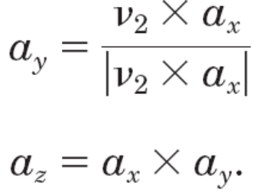
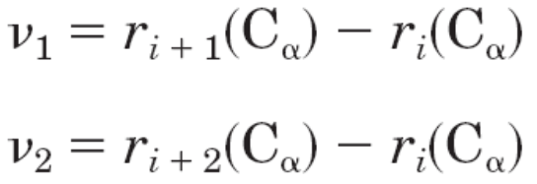
Backbone Reconstruction (cont.)

Slide 11
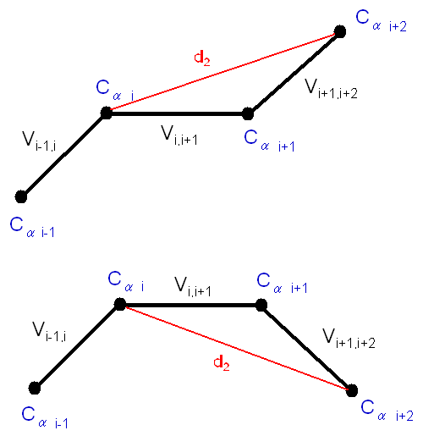
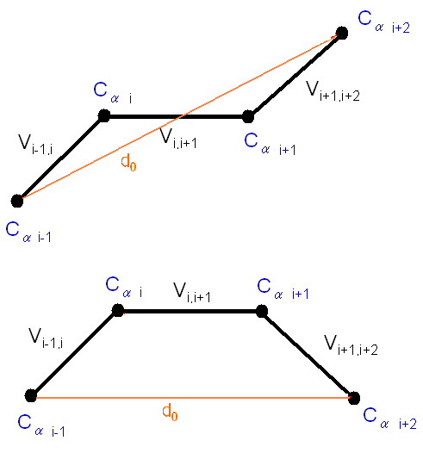
Backbone Reconstruction (cont.)
The chirality of the backbone is taken into account by applying a sign to d₂. Negative values represent left-handed, and positive values represent right-handed conformations as determined from the sign of
[(r_{i}(C_{α}) – r_{i-1}(C_{α})) X (r_{i+1}(C_{α}) – r_{i}(C_{α}))] ˙ (r_{i+2}(C_{α}) – r_{i+1}(C_{α}))

Slide 12
Backbone Reconstruction (cont.)

Slide 13
Side-Chain Placement
The conformer with the side-chain center closest to the low-resolution model is selected and then minimized with respect to the distance of the side-chain center to the model position.
The refinement of the initial rotamer conformation is performed by searching x dihedral angles from first to last with all other angles kept fixed within 20° from the initial rotamer value in 2° increments in both directions until a minimum is found.

Slide 14
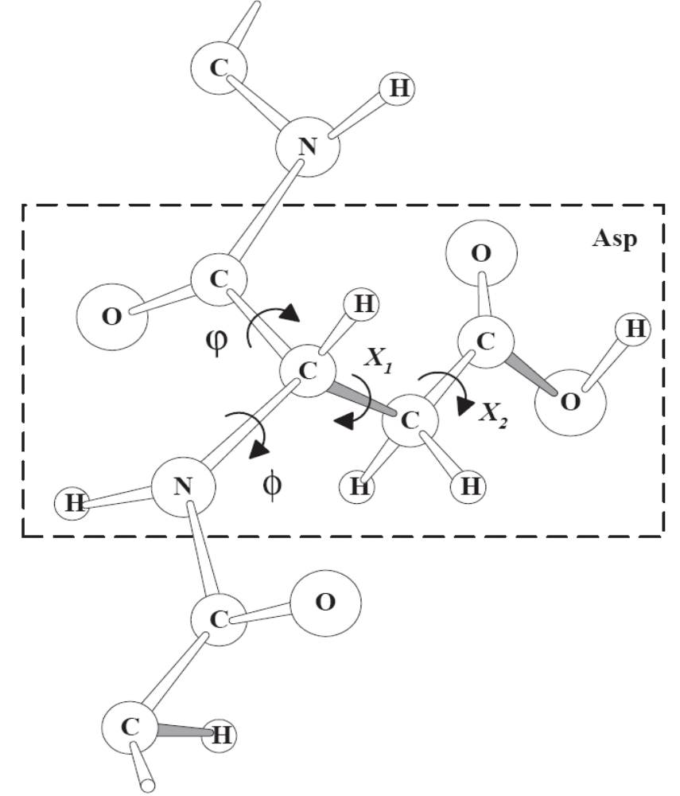
Side-Chain Placement (cont.)

Slide 15
All-Atom Minimization
Here, we show results from minimizing rebuilt structures with the CHARMM²⁹ program using either the PARAM19 united residue force field or the PARAM22 force field with explicit non-polar hydrogen atoms.
In addition to minimizations in vacuum we also used a generalized Born implicit aqueous solvent approximation^{31,32} in conjunction with the PARAM19 force field.

Slide 16
Test Structures
We tested the reconstruction procedure on 13 structures for which high-resolution data at 1.0 Å or better is available from X-ray crystallography.
  1AB1 (0.89 Å, 46 residues), 1BRF (0.95 Å, 53 residues),
  1BYI (0.97 Å, 224 residues), 1CEX (1.00 Å, 197 residues),
  1GCI (0.78 Å, 113 residues), 1IXH (0.98 Å, 321 residues),
  1NLS (0.94 Å, 237 residues), 1RB9 (0.92 Å, 52 residues),
  2ERL (1.00 Å, 40 residues), 2FDN (0.94 Å, 55 residues),
  2PVB (0.91 Å, 103 residues), 3LZT (0.92 Å, 129 residues),
  7A3H (0.95 Å, 300 residues).

Slide 17
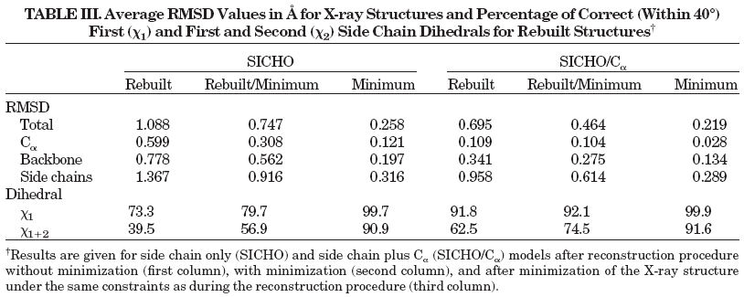
Results

